Slide 1
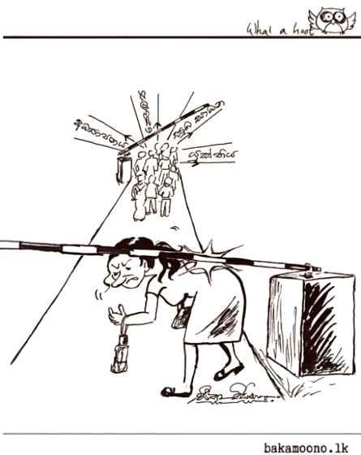

Slide 2


Slide 3
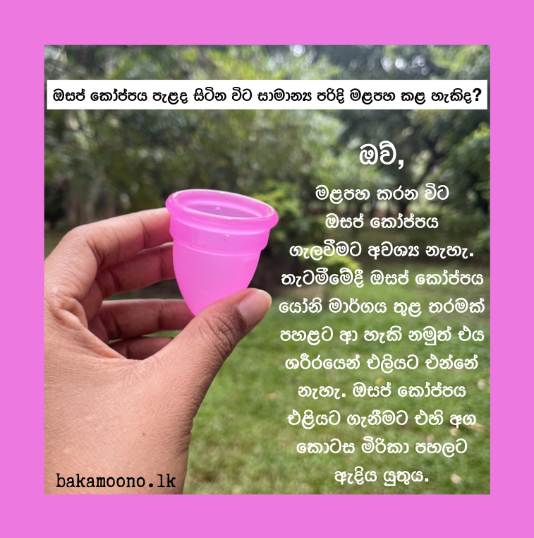
Can you urinate normally while wearing a menstrual cup?
Yes.
A menstrual cup stays inside the vaginal canal, and urine flows through a separate passage (a different tube in the body), so the two functions do not interfere with each other.
If you want to remove the menstrual cup, gently pinch the base to release the seal and pull it down slowly.

Slide 4
Can you sleep while wearing a menstrual cup? Will there be any blood leakage?
No.
Since the menstrual cup stays sealed inside the vaginal canal,
blood will not leak.
You can have a comfortable sleep…

Slide 5
If you wear a menstrual cup for a full day, can it get stuck inside the body?
No.
Even if you wear it for a full day, it will not get stuck inside.
However, it is recommended to empty it at least every 12 hours.
A menstrual cup cannot go further up inside the body.

Slide 6
Does using menstrual cup for long time make the vagina bigger?
No.
The vagina is made of elastic tissues which means it can contract and relax easily. The menstrual cup does not make the vagina bigger.

Slide 7



Slide 8



Slide 10

Blood
Vaginal Fluid
Semen
Anal Mucus
Breast Milk
bakamoono.lk
The HIV virus is only transmitted through these fluids.

Slide 11

People on the right HIV treatment #cantpassiton

Slide 12



Slide 13



